Slide 1
Topic 1 – Class Introduction
Data Science for Business
Prof: Chris Volinsky
NYU Stern: Spring 2025

Slide 2

Why Data Science?
[image of a data scientist in a business environment – Dall-E ]
Notes:
Why data science
What are the uses of data science in your fields? Or cool applications of data science you hope to learn about…

Slide 3

What do you hope to get out of this course?
[make her more successful]
build a strong technical foundation
practice some real-world applications
I wanted to do some coding
make data-driven decisions
I think data science is fun
extract business insights from data
Do my own discovery from data
Link Data Science with the business world
Required for my degree

Slide 4

(My) Class Goals
Learn how to approach business problems data-analytically
Appreciation of the full range of the data science process
Build or expand your knowledge of data science models and methods
Hands on experience with data science tools and algorithms on real problems (using Python)
Discuss application of methods to real business problems through use cases
[Professor teaching data science to business students]
Expectations:
Basic statistical knowledge
Mean v median, spread
Variation, sampling
Concepts of hypothesis testing
Ability to read statistical graphs
Basic python knowledge
Notes:
Toolbox
Improve data literacy
Class is meant to be practical, focused on data literacy.
Class is not: engineering, math heavy, big data or databases.

Slide 5



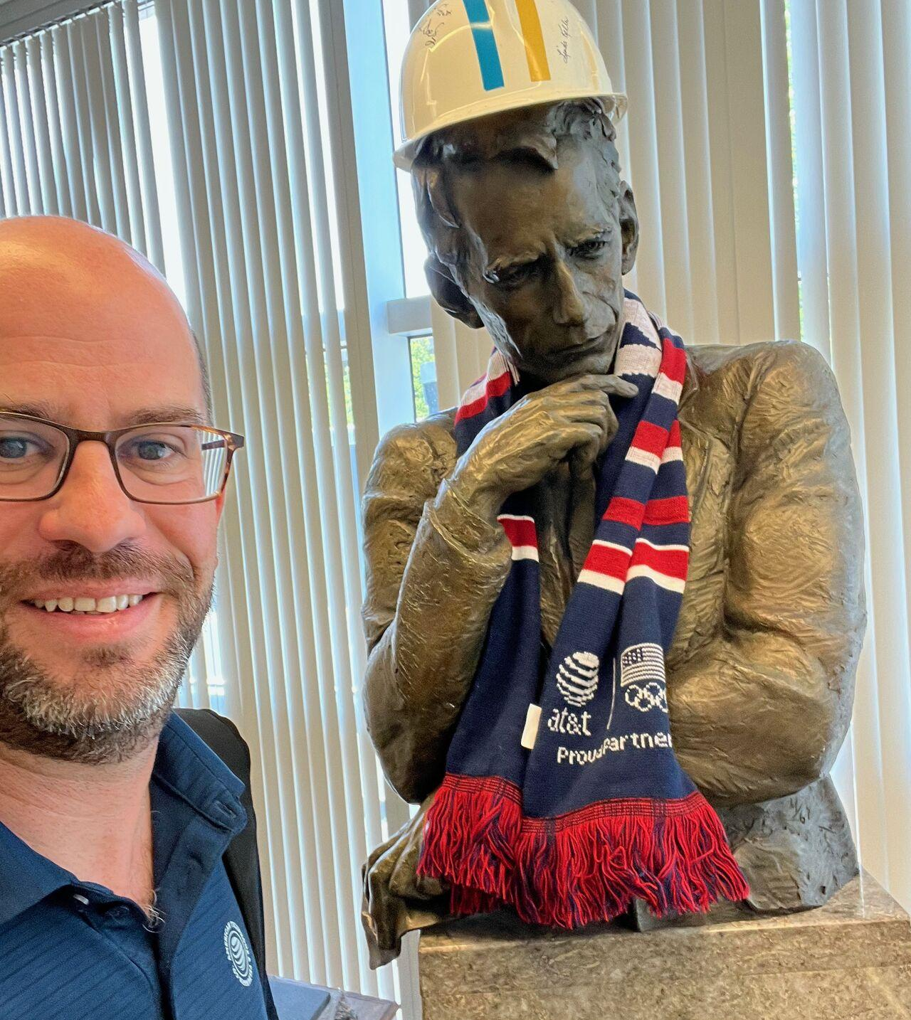
About Me
The best part about being a [data scientist] is you get to play in everyone’s backyard.
- John Tukey, AT&T Bell Labs
Notes:
Tukey said “Statistician” but he was really the world’s first data scientist

Slide 6
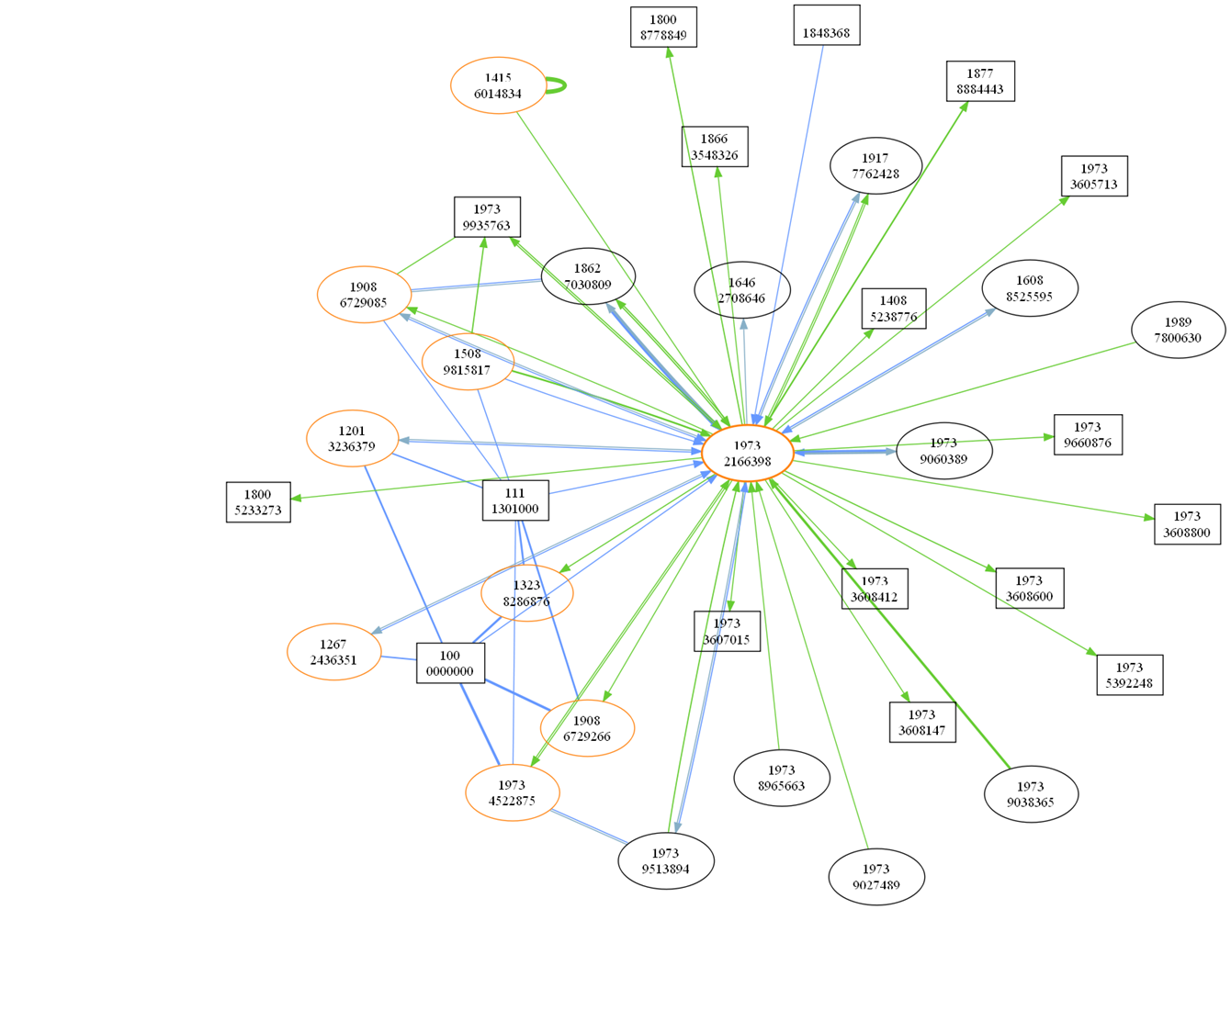
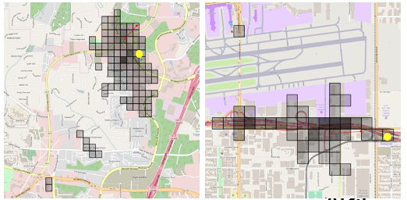
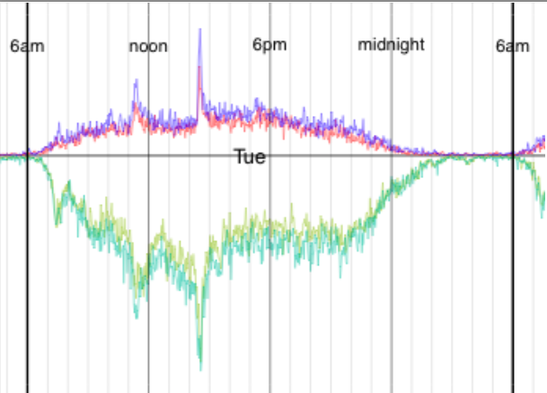
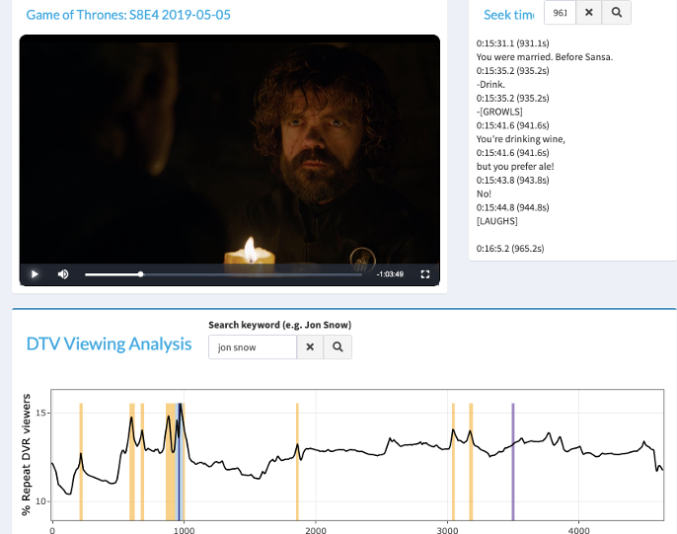
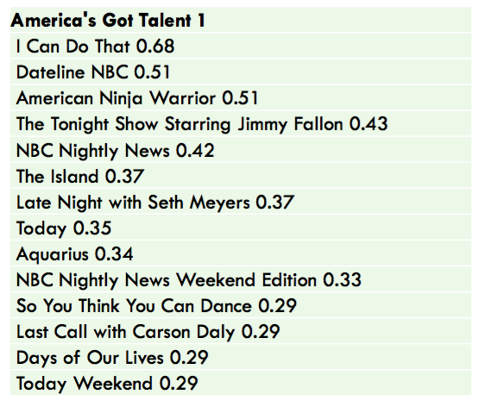
Data Science Projects
Network analytics
Social Networks and Marketing
Content Recommender Systems
TV and Video Consumption
Notes:
As a DS got to work with people in many different fields.

Slide 7

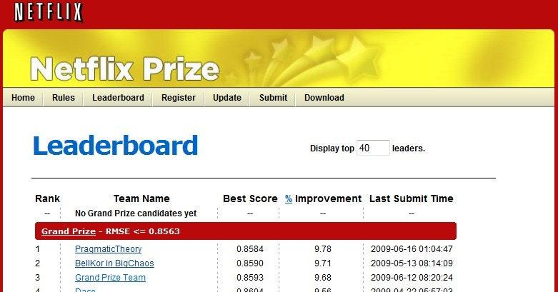
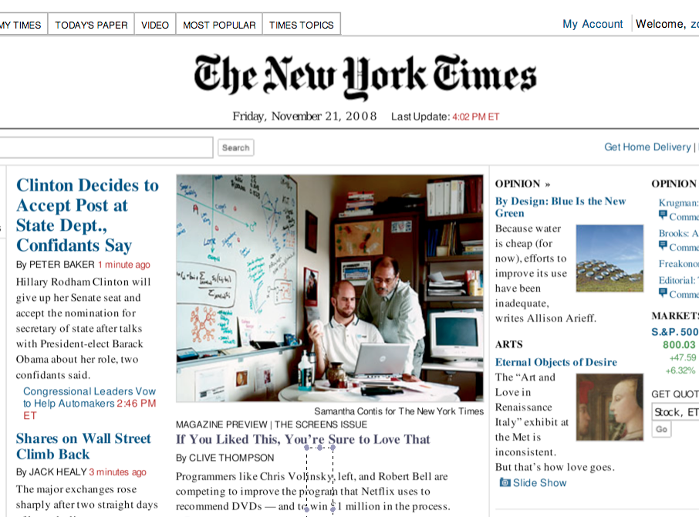
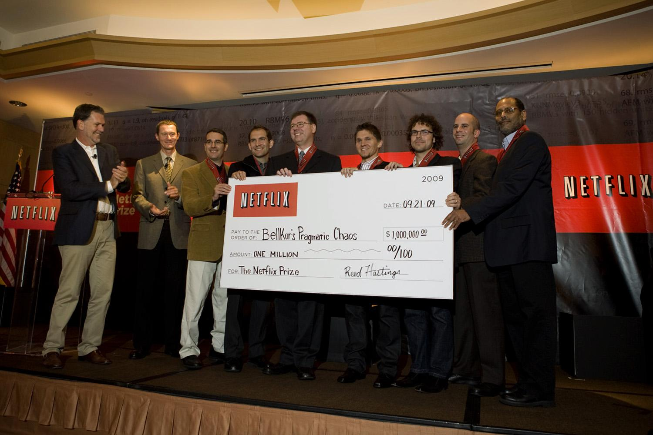
Netflix Prize
An example of data science transforming a business

Slide 8
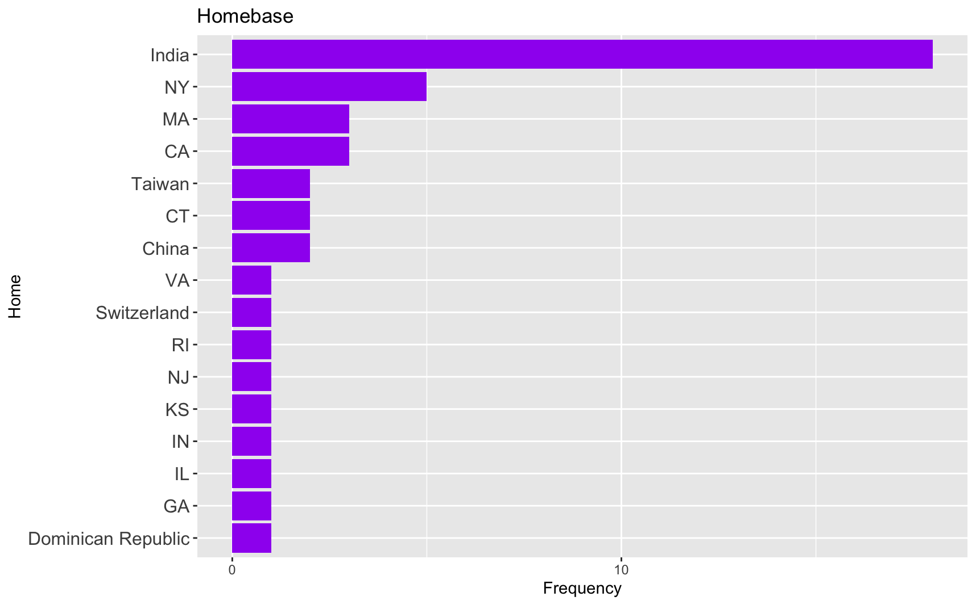
About you… across 2 sections..
Program | Count of Program
Tandon | 17
Full-time MBA | 15
Arts and Sciences | 11
Part-time MBA | 11
SPS | 1
GA-Grad School of Arts & Sci-C | 1
Steinhardt | 1
Grand Total | 57

Slide 9
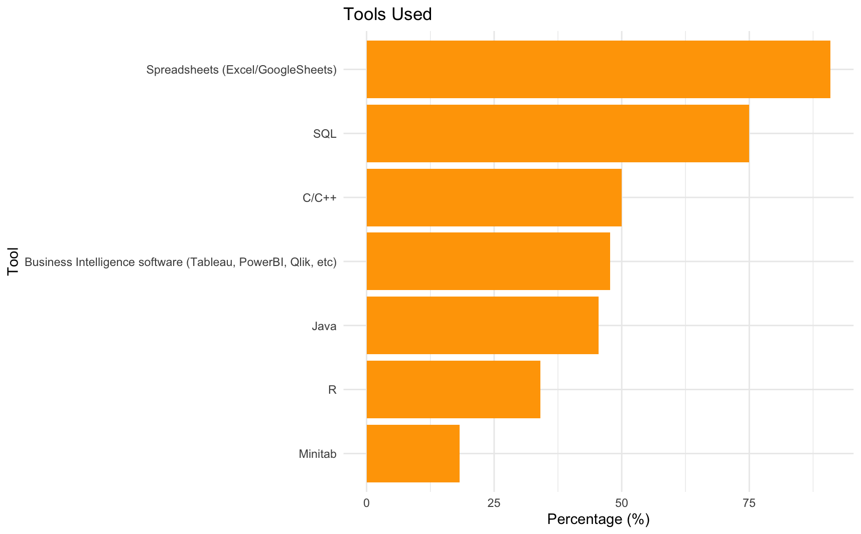
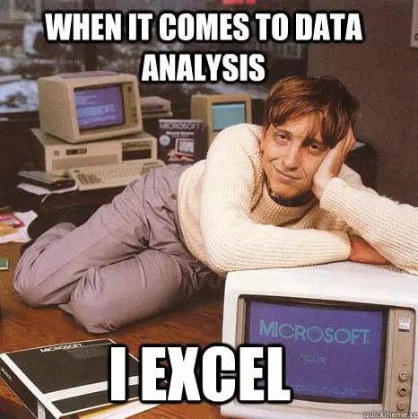
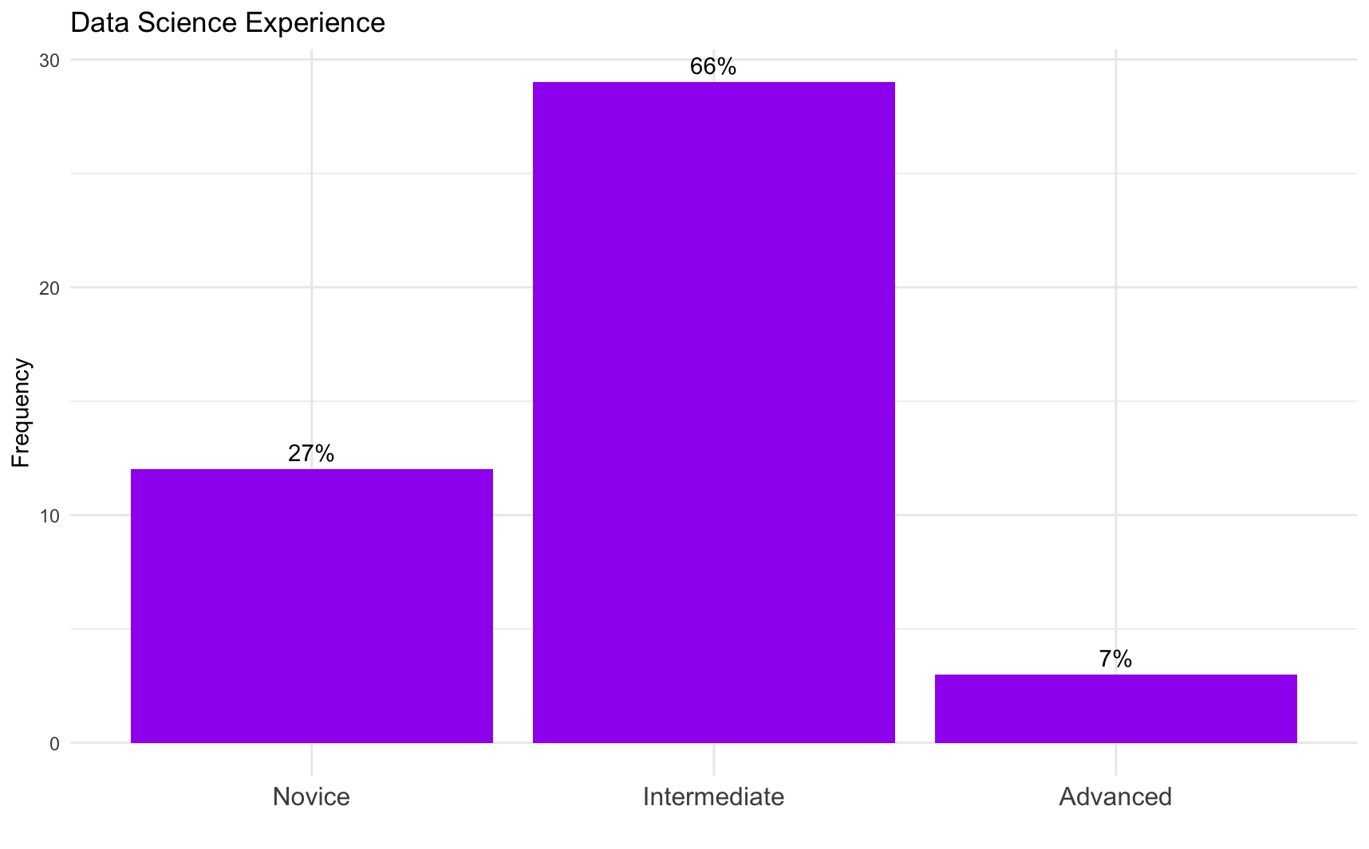
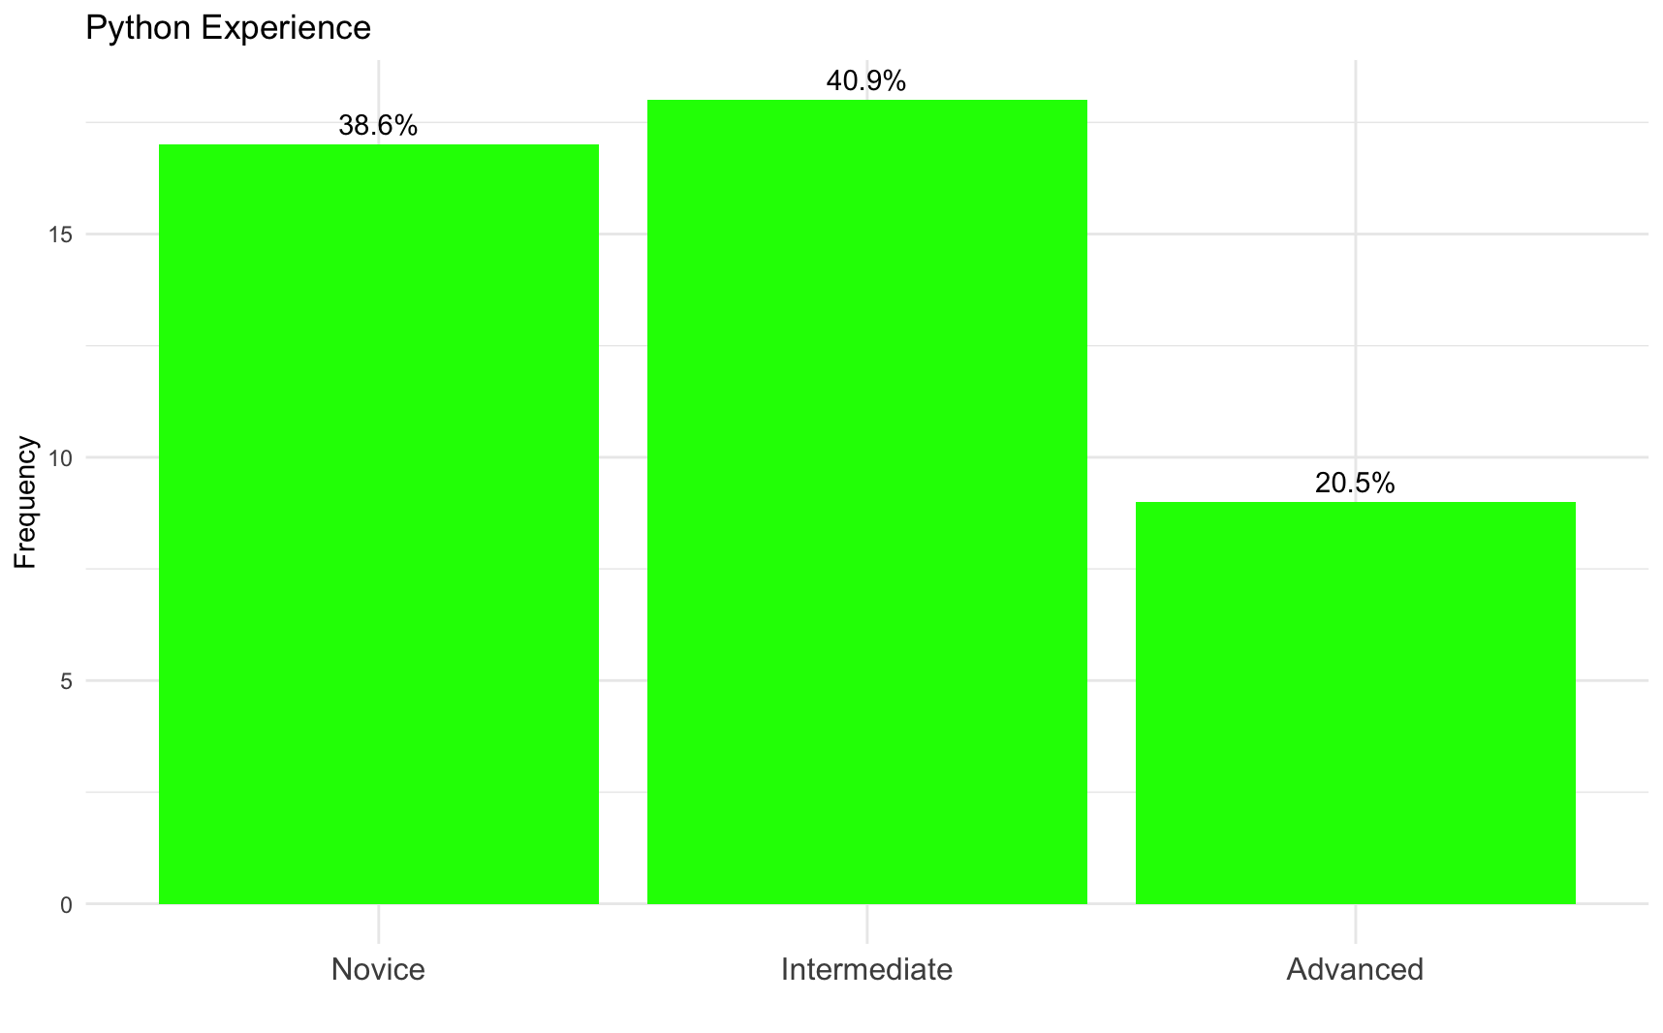
Tools…

Slide 10
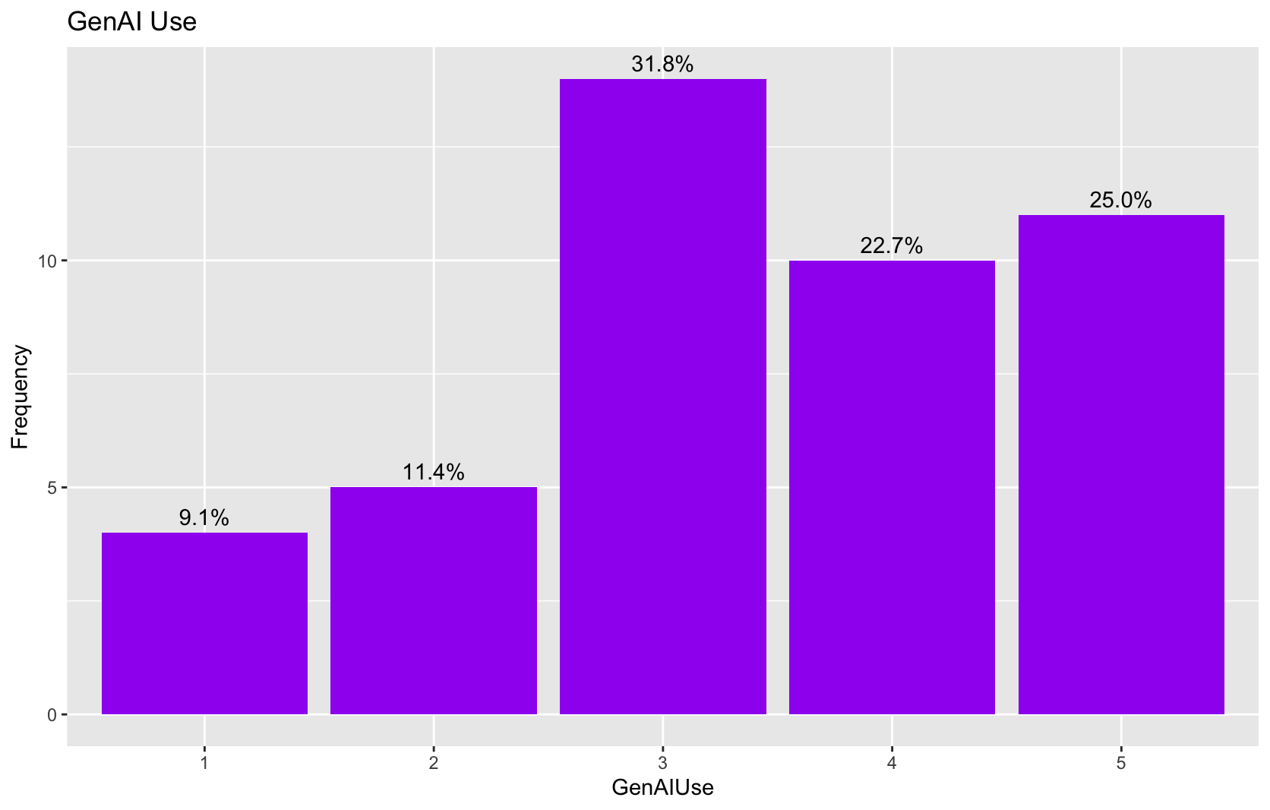
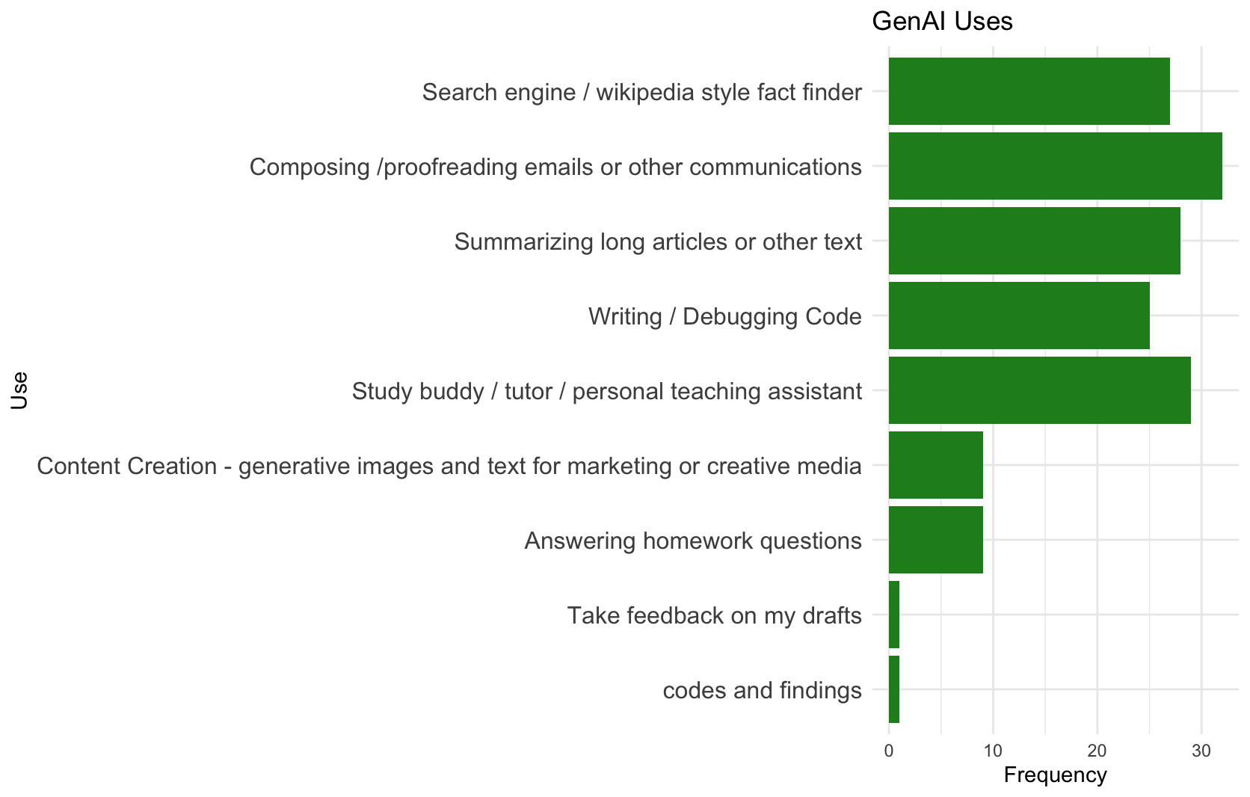
GenAI

Slide 11
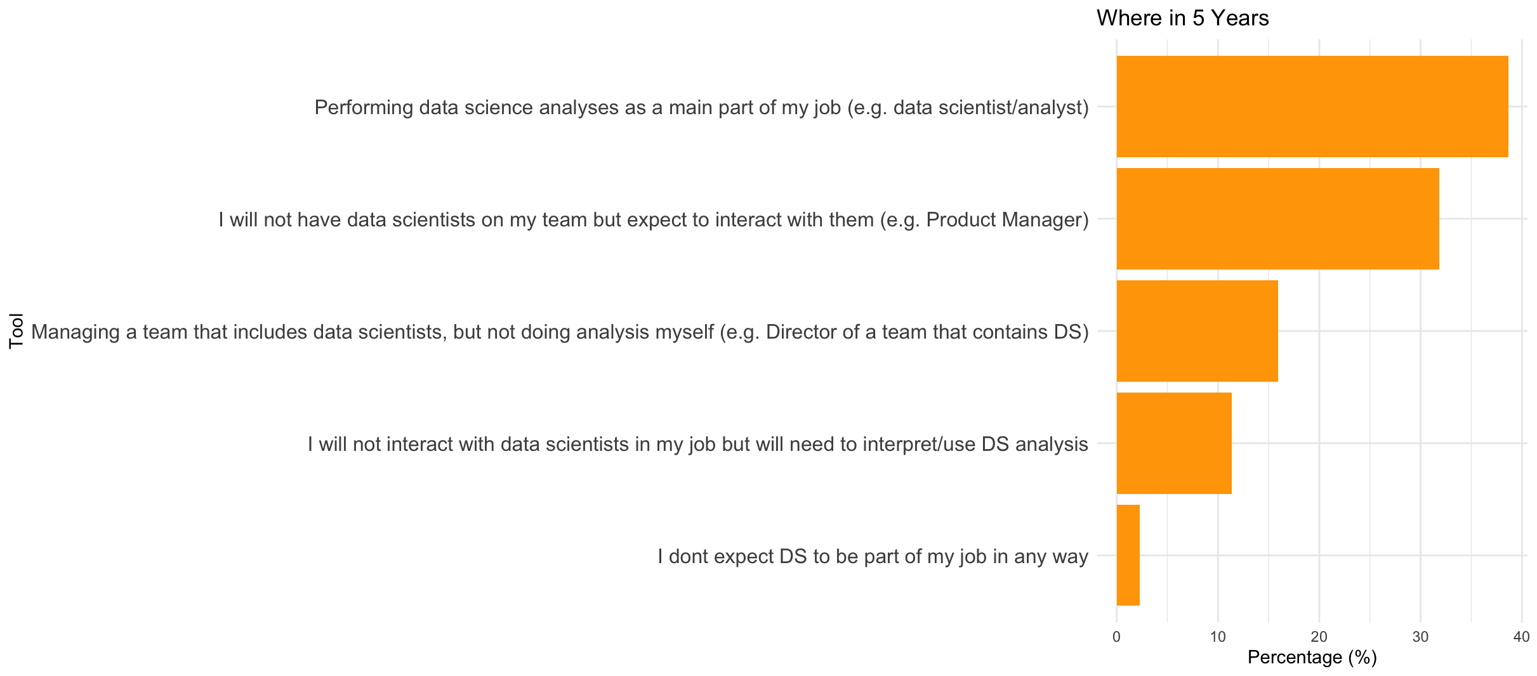
Five Years On..

Slide 12
Music and Food
Saigon Shack | 3
Court Street Grocers | 2
Soho Sushi | 2
Springbone | 2
Taco Mahal | 2
+19 others | 1
Coldplay | 5
Taylor Swift | 5
The Weeknd | 3
Arijit Singh | 2
Bruno Mars | 2
Chappell Roan | 2
Charlie Puth | 2
Cigarettes After Sex | 2
Ed Sheeran | 2
Imagine Dragons | 2
Jeremy Zucker | 2
Sabrina Carpenter | 2
Twenty One Pilots | 2
+ 50 others | 1
Starbucks | 5
Matto | 3
Panera Bread | 3
Blank Street | 2
Caffe Reggio | 2
Heytea | 2
Joe's Coffee | 2
Pret | 2
Stumptown | 2
+13 others | 1
All lists posted on Brightspace / Discussions

Slide 13
About this class…

Slide 14
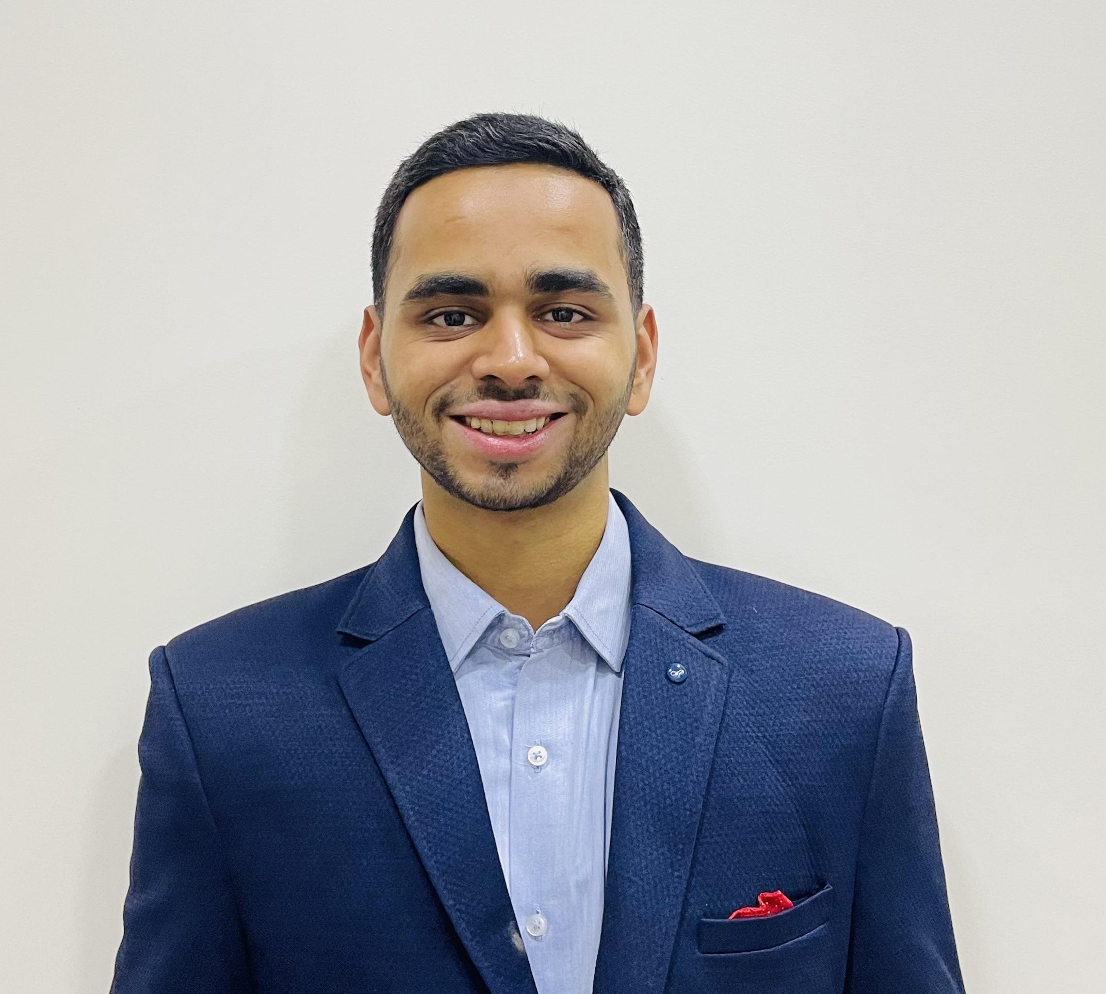
About the Class
Brightspace, Brightspace, Brightspace!
Meet your TA :
Aditya Deshpande
Slides to be posted before class (sometimes just before!)
In-class rules
Attendance will be taken
Bring laptop, but avoid non-class usage of devices
If unavoidable miss of class, catch up via video (BS=>Content=>Mediasite)

Slide 15
Communication
Office Hours
Prof V : Mon 2PM (in office) Tue 6:30 (virtual)
Aditya : Thursday 1pm (zoom link in syllabus)
or by appointment
Python/HW questions should start with TA
Course related or Project related questions can come to me
Helpful: Let us know if you are coming to office hours
Notes:
.

Slide 16

Let’s talk about Python
You don’t need to be an expert, but you do need to know the basics
Work through the introductory notebooks this week – HW0
if you have trouble at this level lets discuss.
Due Friday! (graded only on completion)
Python IDE:
Colab will be what we use in class
For HW, projects you may use other IDEs (VScode, PyCharm, etc)
HW to be uploaded as .ipynb file AND a .pdf file
Pro Tip : Save all CoLab notebooks to your own Google Drive!!!

Slide 17
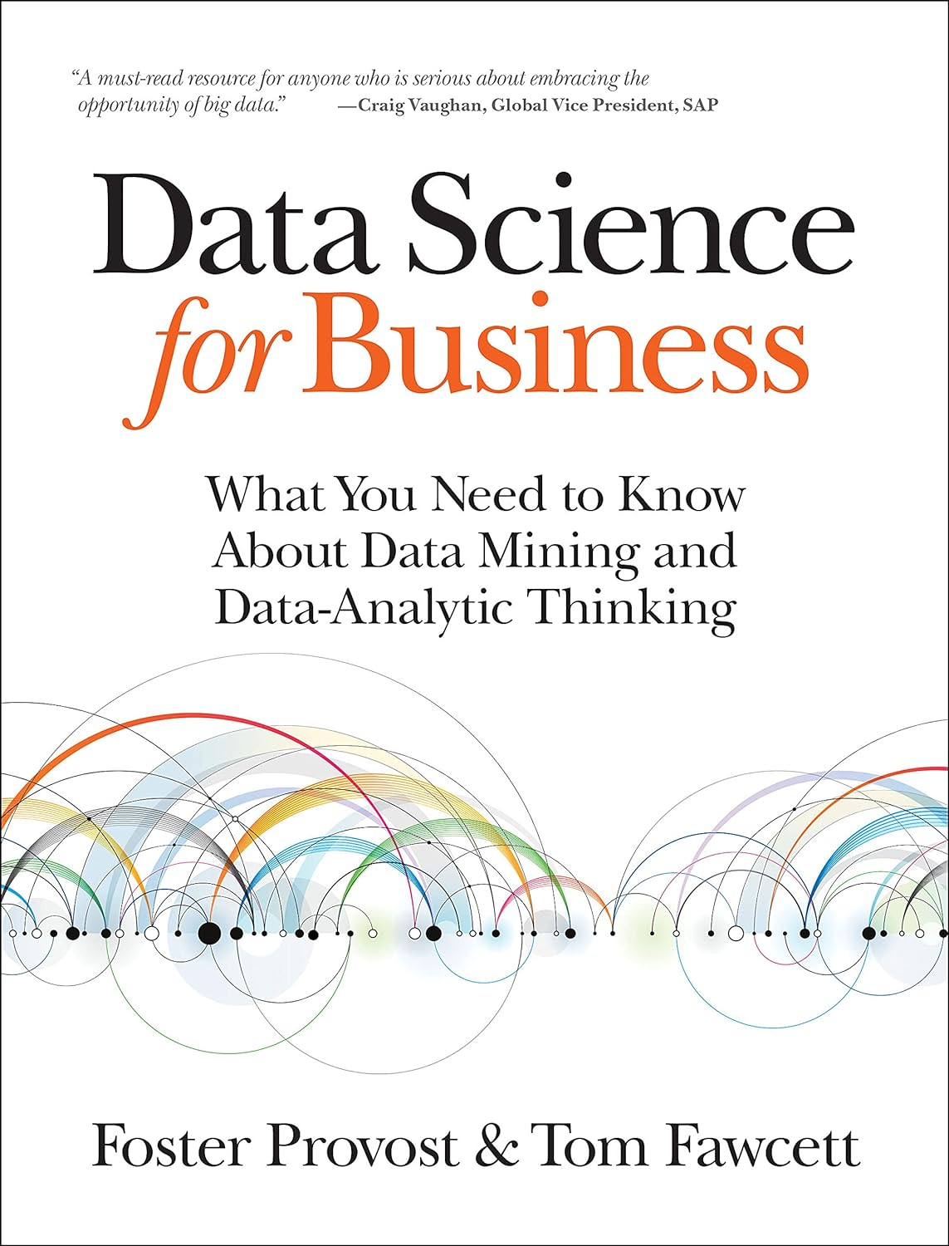
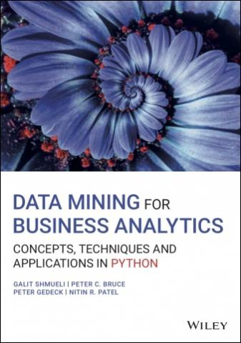
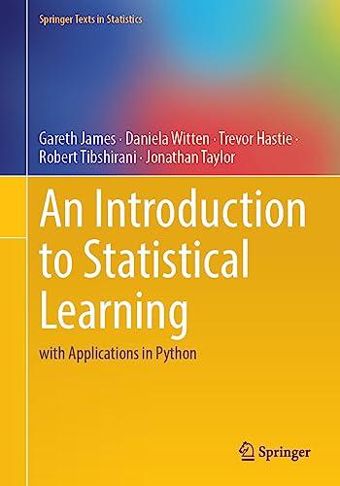

Textbooks
Required Text: Data Science for Business 2e [DSB]
Provost*, Fawcett
Digital version available - see Brightspace for details
Main text – data analytic thinking, business context
Optional Texts (all freely available – see syllabus)
ntroduction to Statistical Learning
An Introduction to Statistical Learning (with applications in Python) [ISLP]
More technical, deeper topics, python code
Data Mining for Business Analytics (with applications in Python) [Shmueli]
Lots of good examples and code
OpenIntro to Statistics [OpenIntro]
Statistics refresh
*NYU Stern prof

Slide 18
Grades
HW (4) 30%
Assigned and collected in Brightspace
Late HW:
25% reduction < 24 hr
50% reduction < 72 hr
HW are detailed
Start early!
Take advantage of TA office hours
Quiz/Exams (3) 30%
2 in-class quizzes, non-cumulative
At start of class (30 min)
One page of notes allowed
No makeups!
Let me know of conflicts in advance
No final exam
Data Project 35%
Groups of 4
Select your own groups by next week or I will select for you
Multiple deliverables throughout the year
Participation / Attendance : 5%
Show up, engage, participate!
Attendance will be taken
1 “freebie”
Brightspace discussions
Make sure I know you!
Grading
35% of class will get A/A-
NYU Stern Policy
Letter grade updated mid-year
Notes:
3

Slide 19
Class Data Project
Groups of 4 – selected by you or me
Goal: Find a data set that can address a business problem of interest. Use learnings from class to follow the data science process, analyze the data and evaluate the business impact
Deliverables:
Week 2: Finalize teams of 4
Week 4: Initial Topic / Data Proposal
Mid-year: Status Report submitted
Last week of class: In-class Presentations
Finals Week: Written reports (~20 pages) due
Notes:
Finding data and a task is HARD – start early!!!
You will use Python to build and evaluate models
Come with your group to at least one of my office hours to discuss ideas/progress
See detailed description on Brightspace, will discuss more next week
To Do NOW:
Start putting together groups of 4

Slide 20
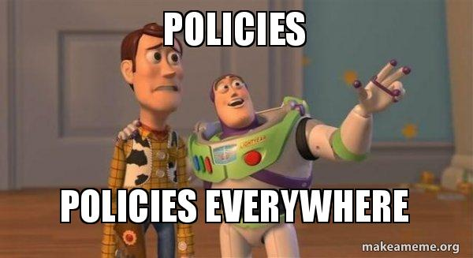
Policies
Religious Holidays
Accommodations
Academic Integrity
Stern Code of Conduct
Please check online syllabus for links and details

Slide 21
Generative AI Policy
Class Policy: Use of GenAI tools is freely allowed
Caveats/Suggestions:
Don’t use GenAI to simply provide the answer
Remember that copy/paste from GenAI can be considered plagiarism
Do use GenAI for
Getting over stumbling blocks for coding
Debugging / error messages
Brainstorming ideas for directions
Asking followups of analysis “any more I can do?”
Ask for an example of the use of a method in a field important to you?
Why would I use method A over method B
Why might I be seeing these results?
Most important – use it as a learning tool! Use it as a way to dig deeper into certain tasks – I would love to hear about how you use it effectively
“use AI to train your brain”
Notes:
Plaigiarism point: can detect when it is used due to certain words “commendable, intricate, versatile, meticulous”
AI is a natural progression:
Phones we didn’t have to remember numbers
Internet we didn’t have to remember facts
Email storage we didn’t need to remember ocnversations
We just have to adjust

Slide 22
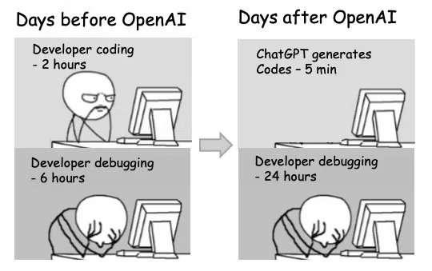
GenAI for Coding Guidelines
Generative AI is incredible for coding:
Tools are built into all of the IDEs, including Colab
It’s very easy to ask GenAI to do coding for you!
Guidelines:
Break big problems into chunks – “what would be the next step..”
It can be wrong! – always review and check answers for reasonableness
Try it yourself first! Use AI as your assistant / tutor not as a contractor
Explain errors
Learn by asking about commands, syntax, parameter
Notes:
Don’t need to build the car, need to drive the car
Why did you do this, what is that parameter

